Slide 1

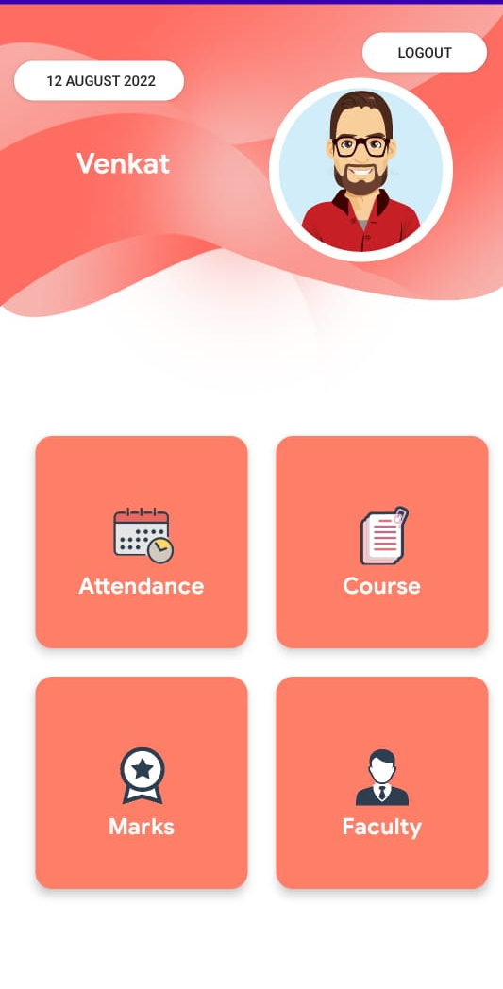
Infomata
Student App
TEAM
Mano Vikram 21MCA0024
Palak Jain 21MCA0070
Venkat Prasad 21MCA0175

Slide 2
Work Timeline

Slide 3
Infomata
Timeline
START
App Idea
The basic idea of the app is to create a platform for students to manage and access all academic details.
Wireframe
Basic wireframe design is being craeted .

Slide 4
Listing Features
Students can view their attendance, marks, courses, faculty details and much more.
Final App
The final app has a beautiful UI which is fully functional and comfortable to use.
FINISH

Slide 5
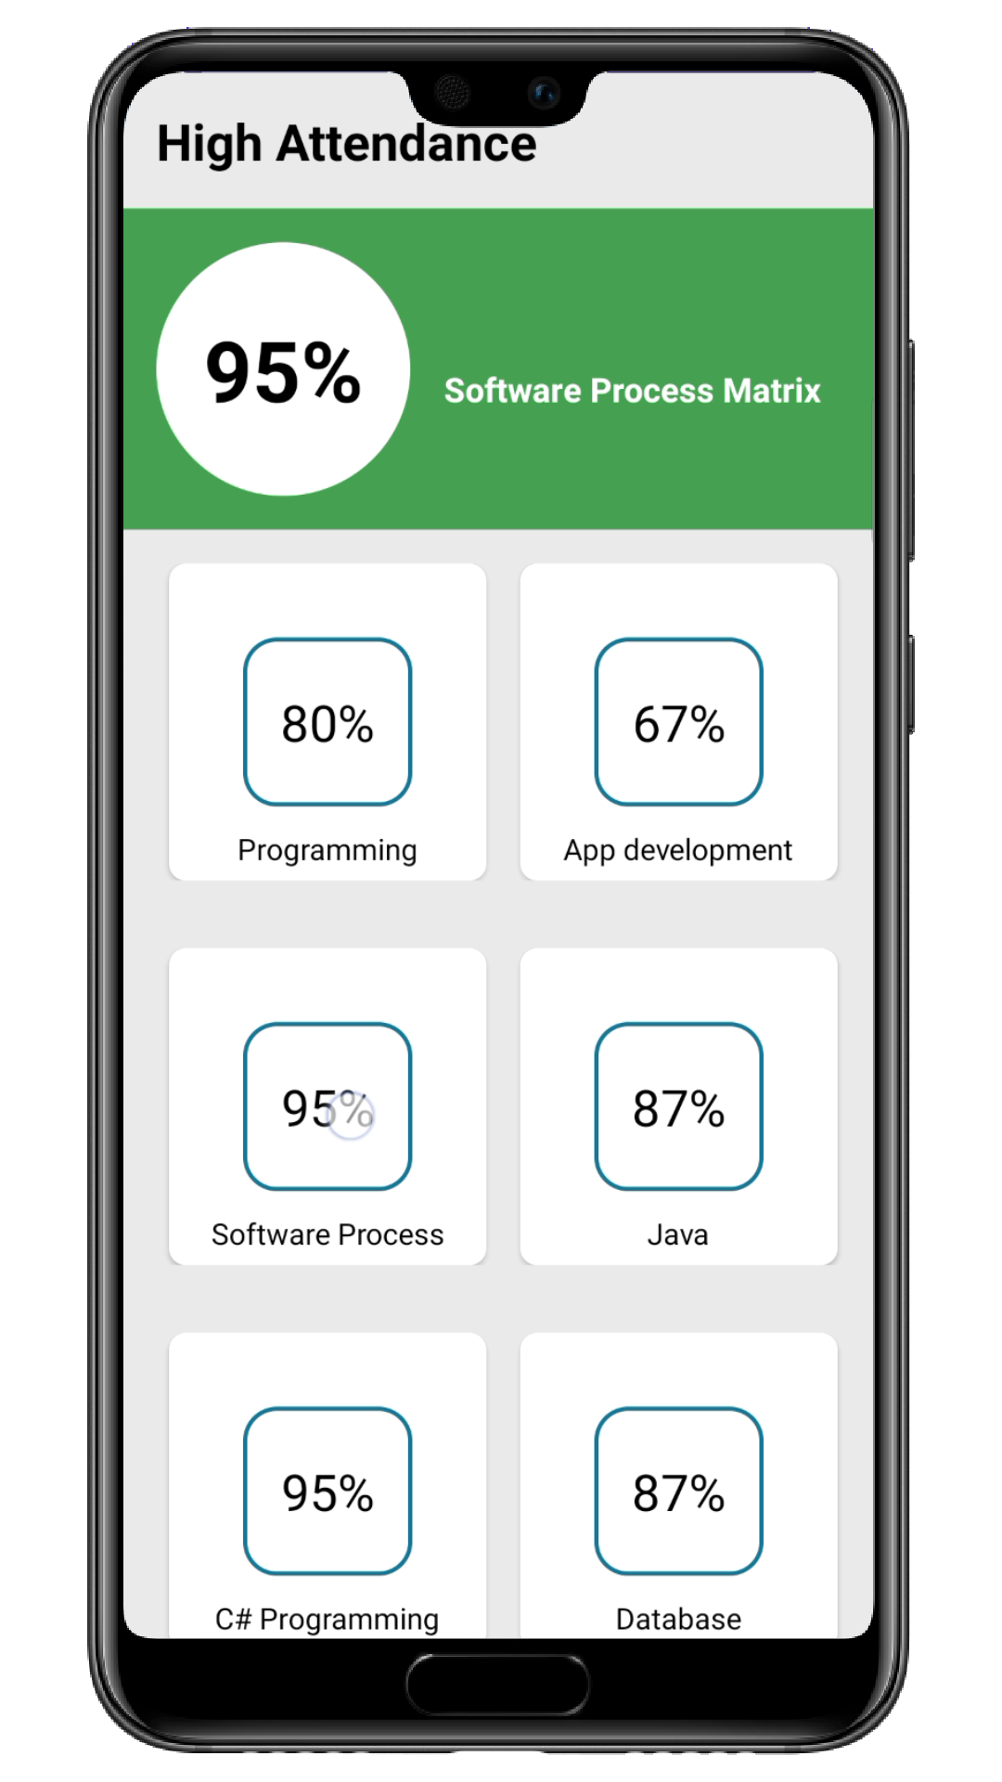
FEATURES
Login & Signup
→

Attendance
Infographics
→
⬧
Faculty Details
Academic Calendar


Courses
⬆

Class Overview
Marks

Slide 6
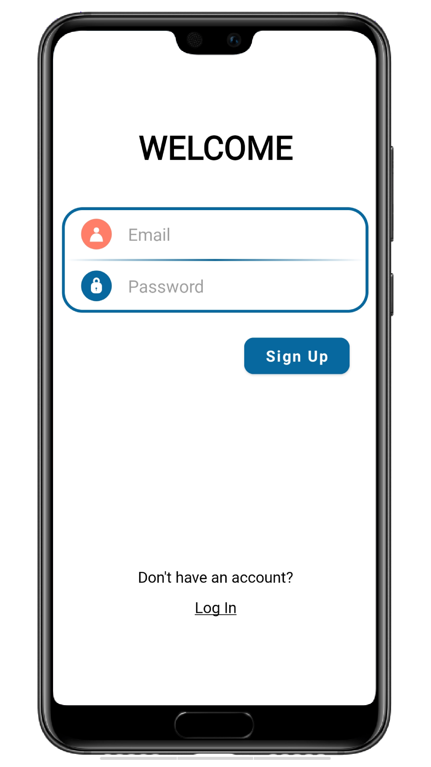
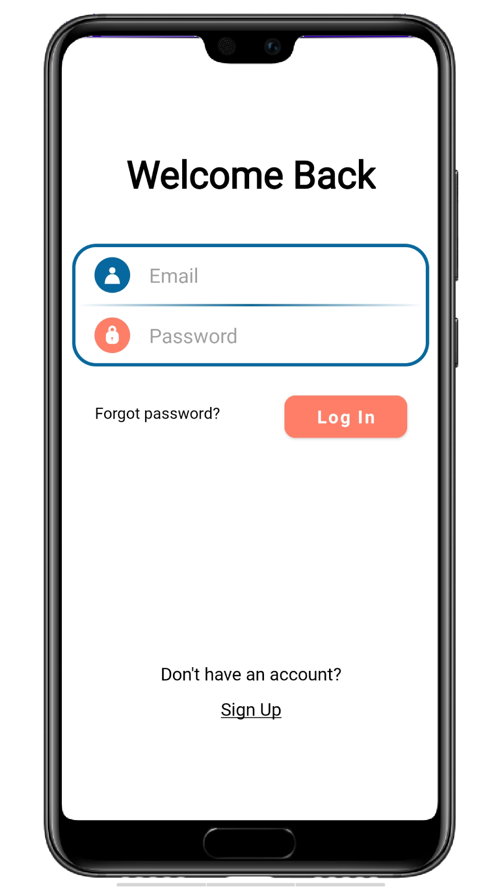
01
Login Screen

Slide 7
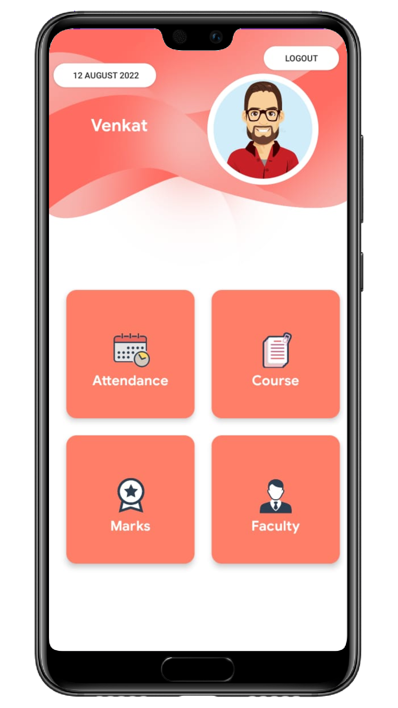
02
Home Screen

Slide 8

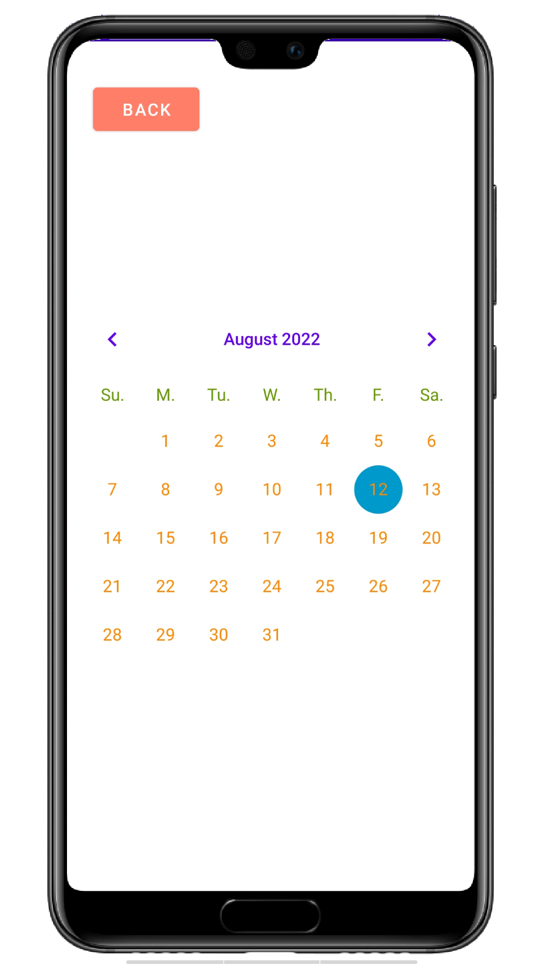
03
Academic Calendar

Slide 9
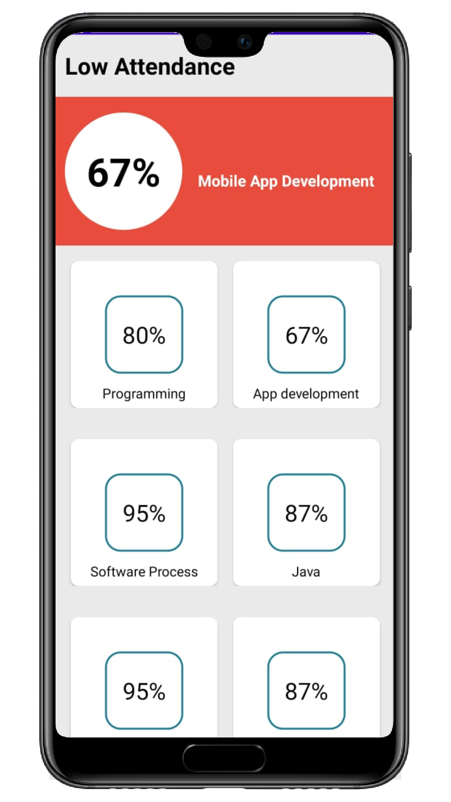
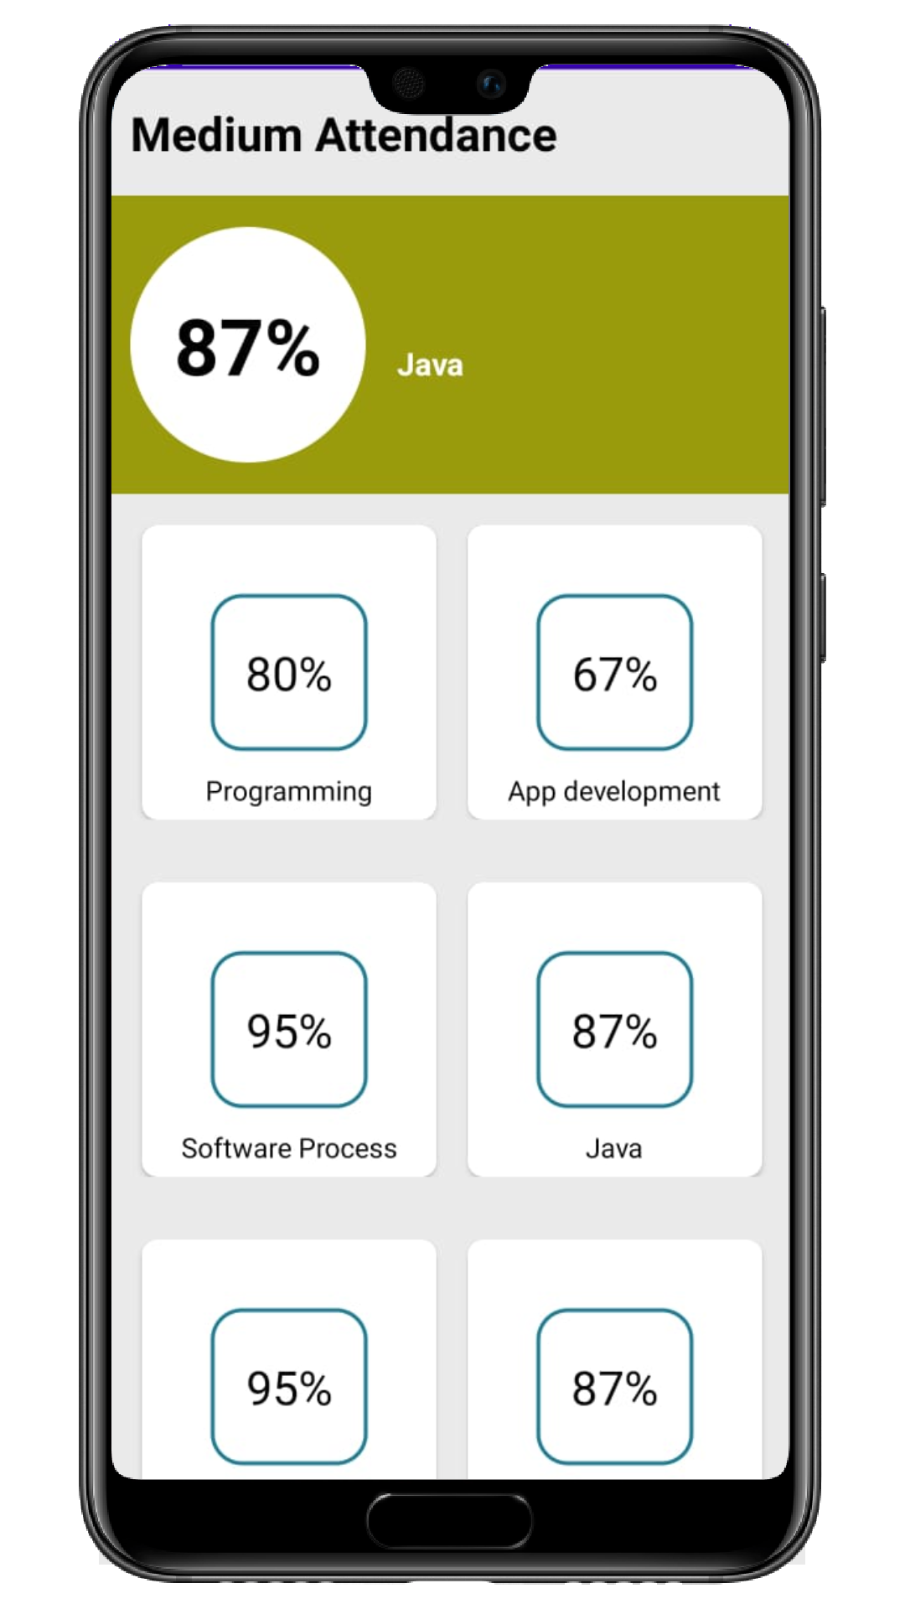
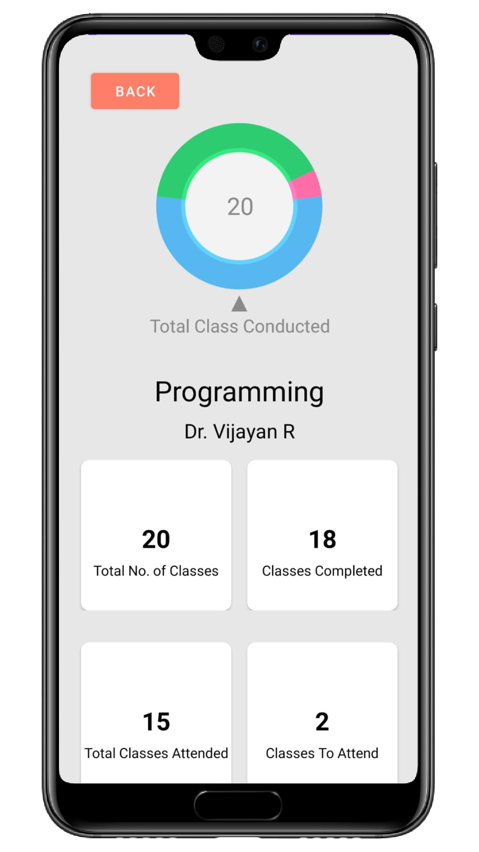
04
Attendance

Slide 10
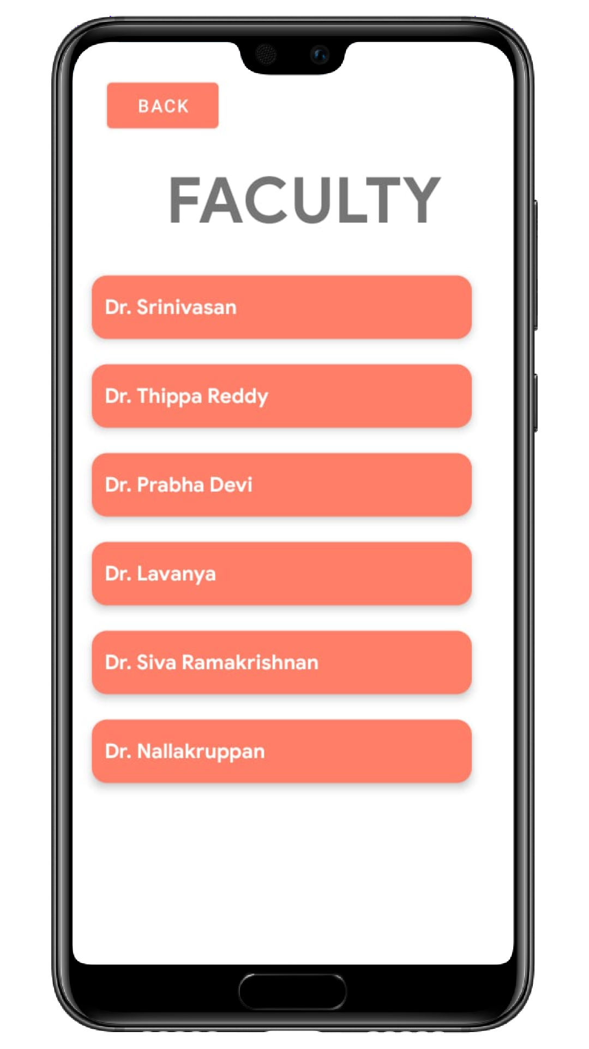
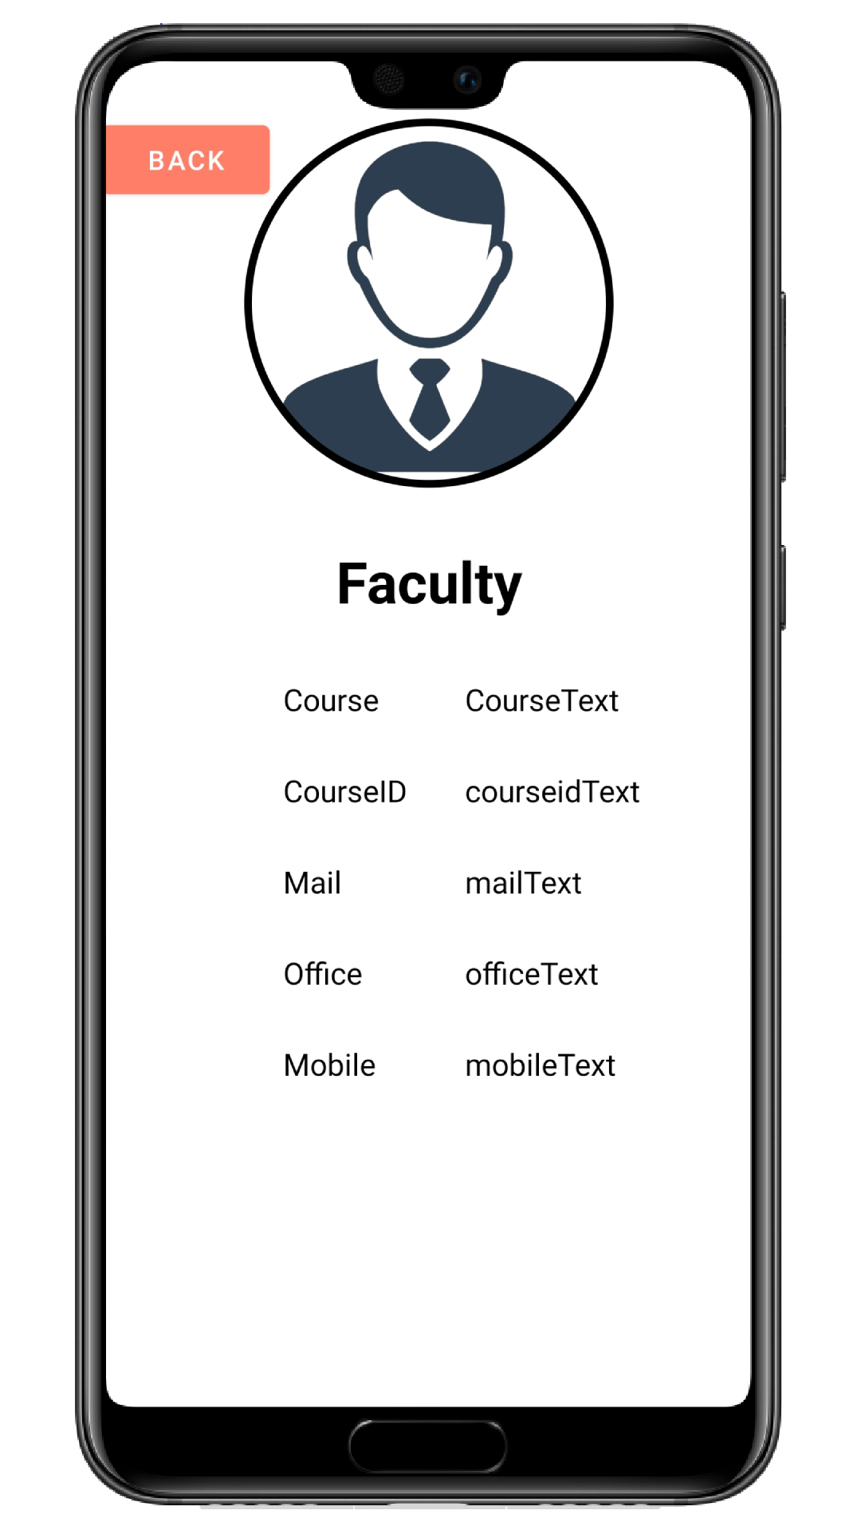
05
Faculty

Slide 11
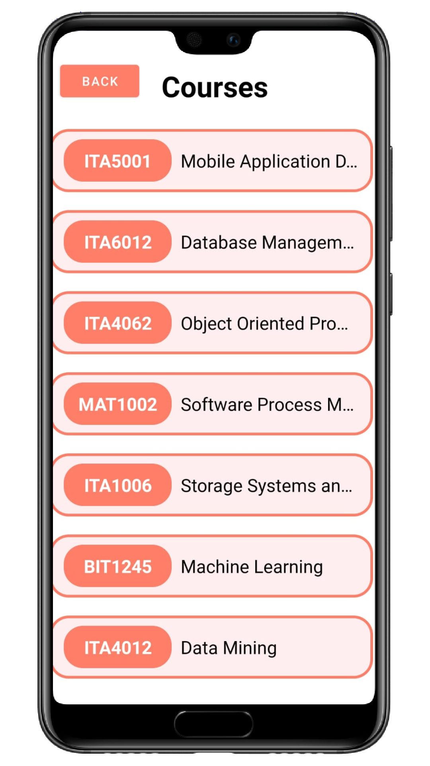
06
Courses

Slide 12
THANK YOU!
Team
Infomata

